Slide 1
Developing A Growth Mindset: The Power of “Yet”
Admission Network, LLC

Slide 2
"It is not the critic who counts; not the man who points out how the strong man stumbles, or where the doer of deeds could have done them better.
The credit belongs to the man who is actually in the arena, whose face is marred by dust and sweat and blood, who strives valiantly; who errs and comes short again and again;
because there is no effort without error and shortcomings; but who does actually strive to do the deed; who knows the great enthusiasm, the great devotion, who spends himself in a worthy cause, who at the best knows in the end the triumph of high achievement and who at the worst, if he fails, at least he fails while daring greatly.
So that his place shall never be with those cold and timid souls who know neither victory nor defeat.”
Theodore Roosevelt, 1910

Slide 3
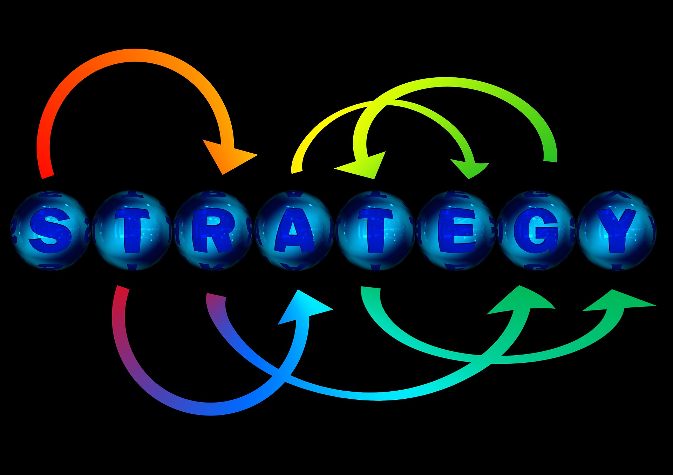

Slide 4
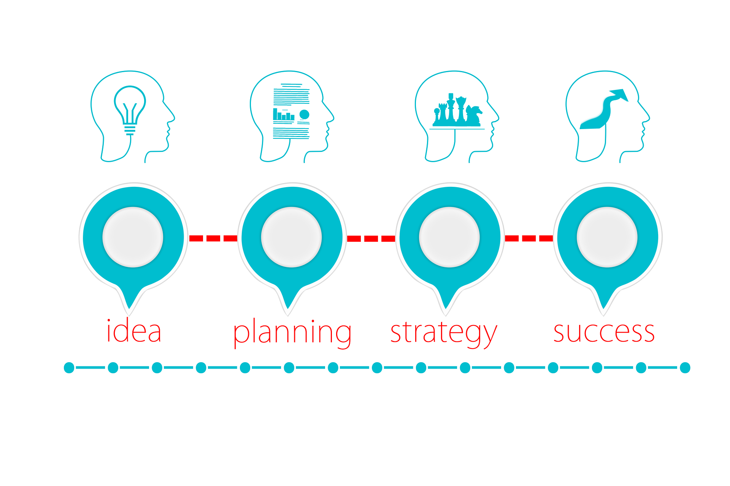
Team strategy
Every single person on the Team has to produce every day
We are only as strong as our weakest link
Think about who on the back of your card
could help you with your challenge?
Celebrate Success
Work on all sides of the Cube
Co-Create – Widespread Involvement
Continuously Remake the Organization
Absorb Complexity for Families
Prepare for Growth and Cuts

Slide 5
Everything Your 1st Grade Teacher Taught You
(But On A More Mature Level)
Exercise,
Page 68

Slide 6
Are You in Your Comfort Zone?

Slide 7
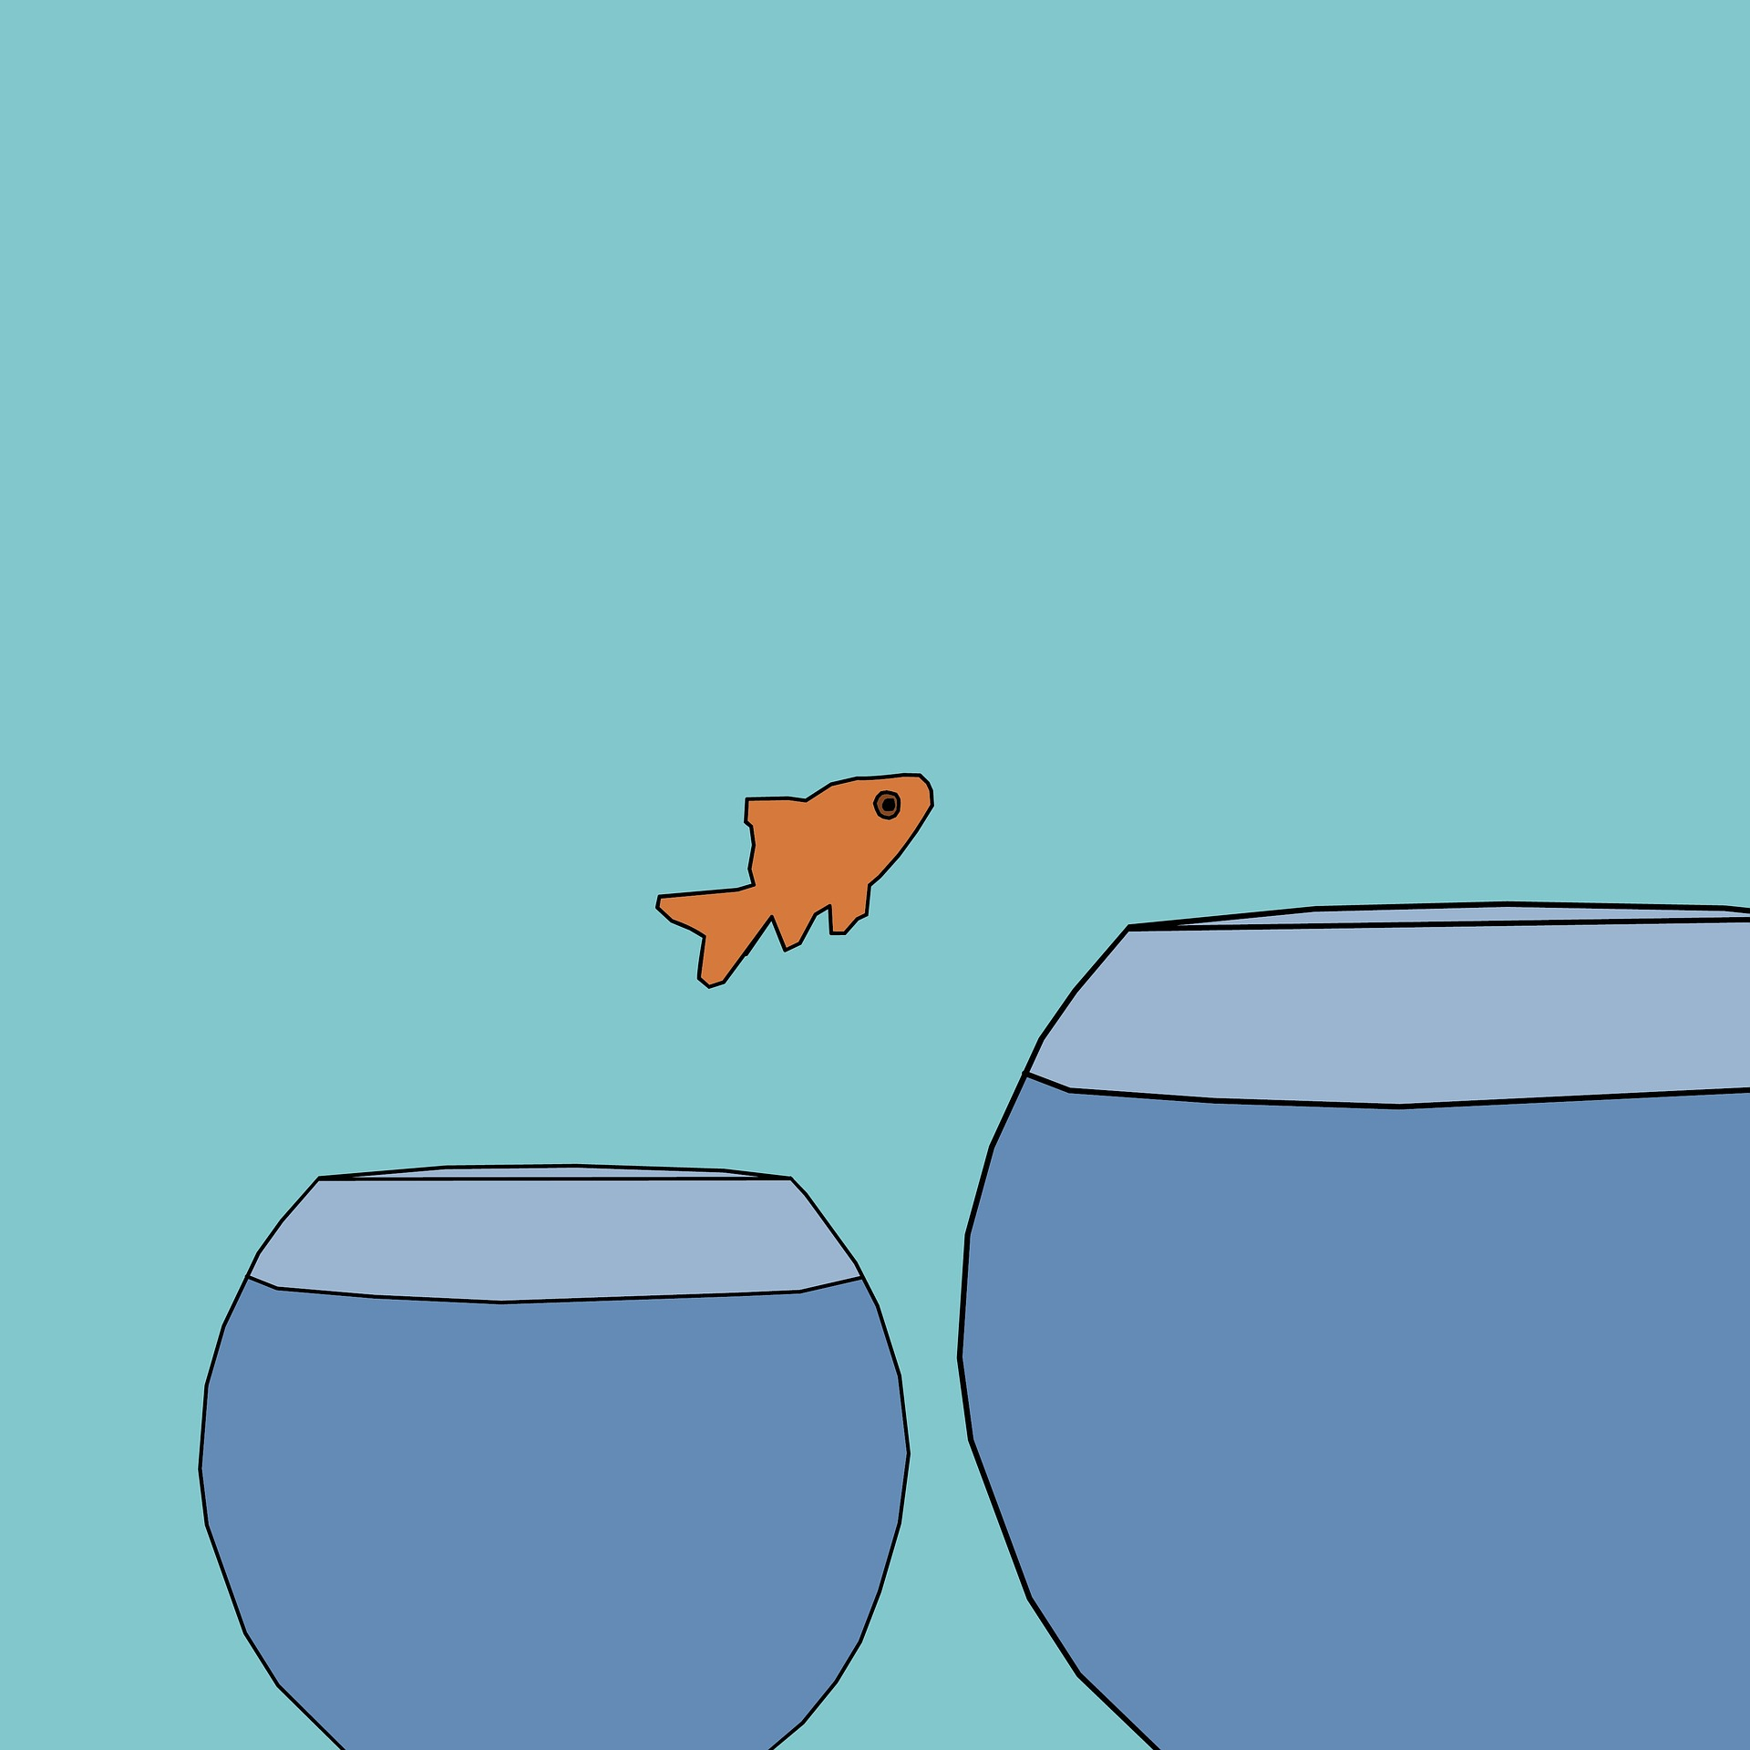
“Staying within your comfort zone is a good way to prepare for today, but it’s a terrible way to prepare for tomorrow.”
David Peterson, Google

Slide 8
BENEFITS
OF A
GROWTH MINDSET
HEALTH
MINDFULNESS
WORK LIFE BALANCE
LESS CORTIZOL
STRESS
LONGIVITY
REDUCE ALZHEIMERS
CAREER TRAJECTORY

Slide 9
This is What We are Going For…

Slide 10
What kind of Mindset Do You Have?
I can learn anything I want to.
I learn from my failures.
I want to challenge myself.
I feel like feedback is constructive.
I am inspired by the success of others.
I always persevere, even when I am frustrated.
My effort and attitude determine everything.
I am either good at it or I am not.
If I fail, I am no good.
I don’t like to be challenged.
I feel like feedback is personal.
If you succeed, I feel threatened.
I give up if I find something difficult.
My abilities determine everything.
Growth
Fixed

Slide 11
failure
What can I do differently next time?
Who could I have collaborated with to ensure a good outcome?
Should I seek training in this?
Take Risks
Bounce back with enthusiasm
“It is hard to fail; but it is worse never to have tried to succeed.”
-Theodore Roosevelt

Slide 12
feedback
Ask for feedback; especially when you are uncertain of the outcome
Listen appropriately to the feedback, nod your head, use positive gestures
Thank them for the feedback
Process the information let them know that you will take their ideas into consideration
“The Problem for most of the people in this building is that they have stopped growing. They aren’t developing, they aren’t changing, they are still stuck in the same mind-set they had 20 years ago.”
The Center for Creative Leadership

Slide 13
Perseverance & grit
Don’t get frustrated; continue the project
Take small breaks if you must
Ask for help if you need it
Realize that true success is difficult
Nothing good comes easy
Use Your “GoTo10”
“It’s not that I’m so smart, it’s just that I stay with problems longer.”
-Albert Einstein

Slide 14
Do you know someone who is . . .
Stagnant
Underperforming
Unwilling to take risks
Frustrated
Quitter

Slide 15
Fixed Mindset
Ambition and Creativity Reduced
Uncertainty & Risk Avoidance
Self-doubt & Worries
Workplace Fosters Failure-avoidance
Ethical Consequences

Slide 16
https://youtu.be/l-gQLqv9f4o

Slide 17
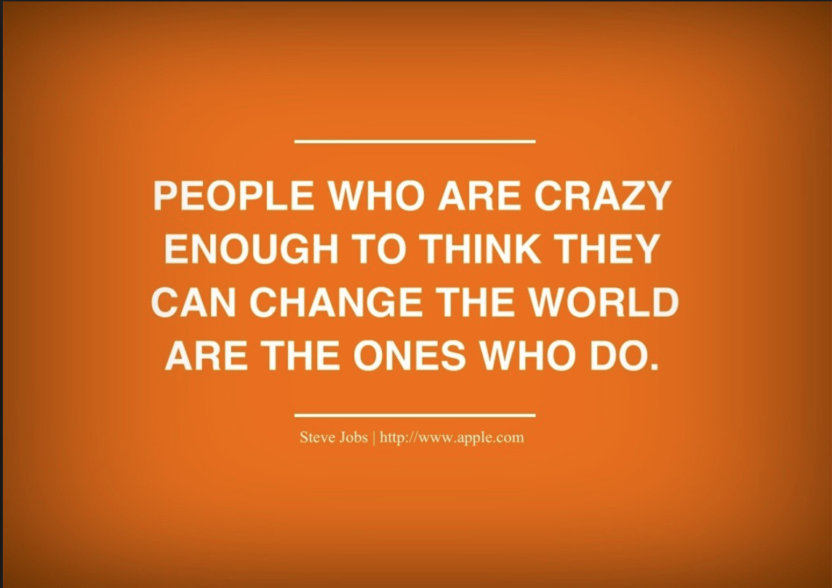

Slide 18
Attitude impacts performance in the classroom, argues Stanford psychologist Carol Dweck.
Students who recognize that intelligence can be deepened through conscious effort reap the benefits of what Dweck calls a growth mindset in better academic performance and greater resilience in meeting intellectual challenges.

Slide 19
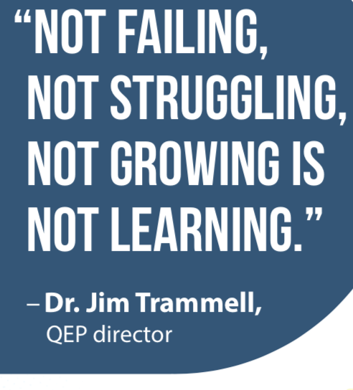
“Important achievements require a clear focus,
all-out effort,
and
a bottomless trunk
full of strategies.
Plus allies in learning.”
- Carol Dweck

Slide 20
Growth Mindset
Making Connections Across Experiences
Let go of approaches that are not useful
Experiment
Seek Feedback
Reflect systematically
Vibrant, energetic
Recognized as active leader

Slide 21
Retrain Your Brain
There are people who believe that everyone can learn, and people who just haven’t figured that out yet.
https://youtu.be/ELpfYCZa87g?t=5

Slide 22
Development
Ask for Feedback – What could I do differently next time?
Experiment with New Approaches – What is one thing I could do to change the outcome?
Reflection – What have I learned from this experience?
Share More – Tell colleagues about a time you failed. Accomplishments and failures have a place in your career story.
Catch Yourself – Next time you judge a colleague harshly; reflect on why
Forgive Yourself – Honor the intentions of your actions; even when they do not always produce success.
Make Leadership Development A Process – Take time to solidify thinking.

Slide 23
Ways to Grow Your Brain Function
https://youtu.be/JgOO_yz0C_Q?t=8

Slide 24
Research – CAROL DWECK
Research demonstrates that accomplishments are derived simply by adopting a belief in one’s capacity to succeed.
Individuals with a growth mindset tend to show a greater sense of free will and stronger desire to learn.
They embrace challenges and show persistence when facing obstacles. They also believe that effort pays off.
They appreciate feedback and learn from their mistakes and they also are inspired by the success of others.
As a result of this growth mindset, such individuals are able to reach higher levels of achievement (Krakovsky, 2007).

Slide 25
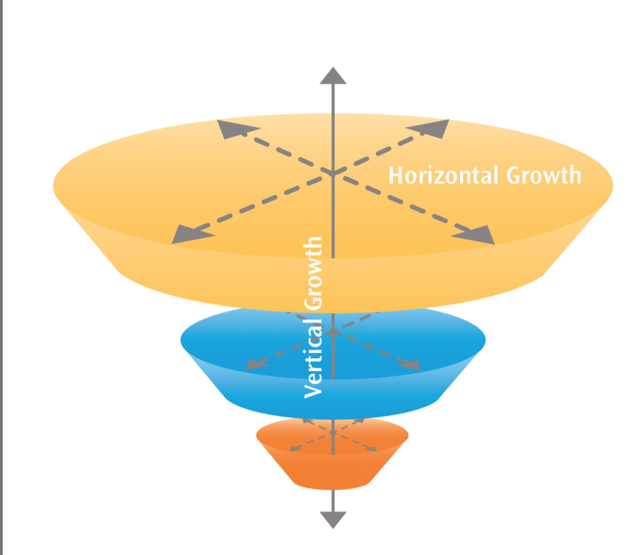
One Step Further: Horizontal and Vertical Growth Model
Master Other People
Elevator Going Up
Increased Responsibilities
Master Ourselves
See & Experience Teams
Multiple Similar Tasks
Tree Analogy
Ideally Not Mutually Exclusive

Slide 26
CENTER FOR CREATIVE LEADERSHIP

Slide 27
Effective leaders
Deal with constant ambiguity
Notice key patterns
Eliminate noise
Look at the world through multiple stakeholder perspectives
VUCA – Volatile, uncertain complex, ambiguous

Slide 28
Example - TECHNOLOGY AND ADMISSIONS
YEAR | MAIL | EMAIL | LANDLINE | INTERNET | CELL PHONE | FACE BOOK | TWITTER | INSTAGRAM | VIDEO | LINKED IN | PINTEREST | TEXT MSGS | CHAT | ZOOM SKYPE
1988 | ☑️ | ☑️ | ☑️ | ☑️
1998 | ☑️ | ☑️ | ☑️ | ☑️ | ☑️ | ☑️
2008 | ☑️ | ☑️ | ☑️ | ☑️ | ☑️ | ☑️ | ☑️ | ☑️ | ☑️ | ☑️ | ☑️ | ☑️ | ☑️ | ☑️
2018 | ☑️ | ☑️ | ☑️ | ☑️ | ☑️ | ☑️ | ☑️ | ☑️ | ☑️ | ☑️ | ☑️ | ☑️ | ☑️ | ☑️

Slide 29
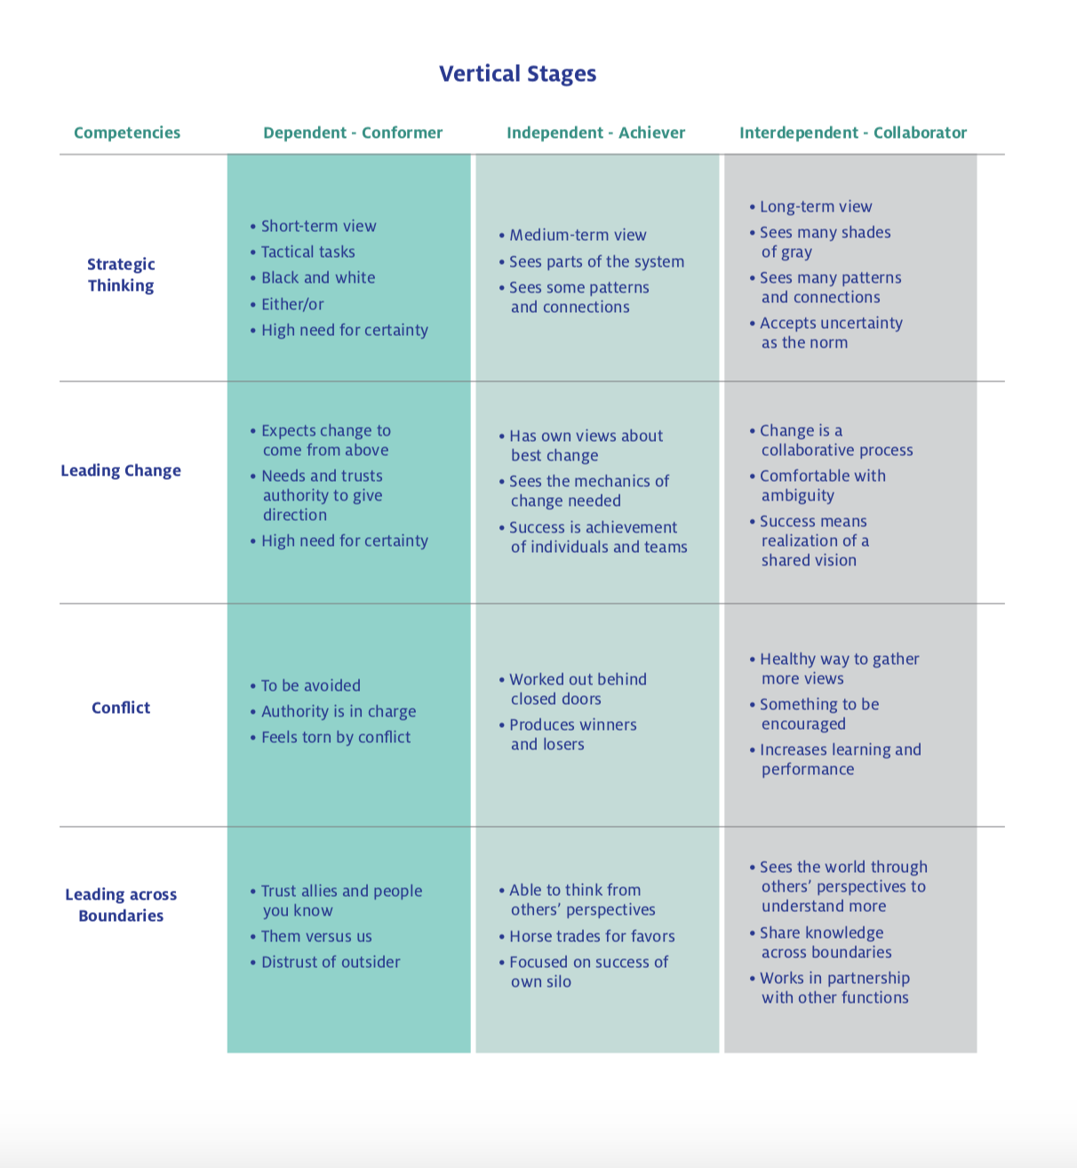
Center for Creative Leadership

Slide 30
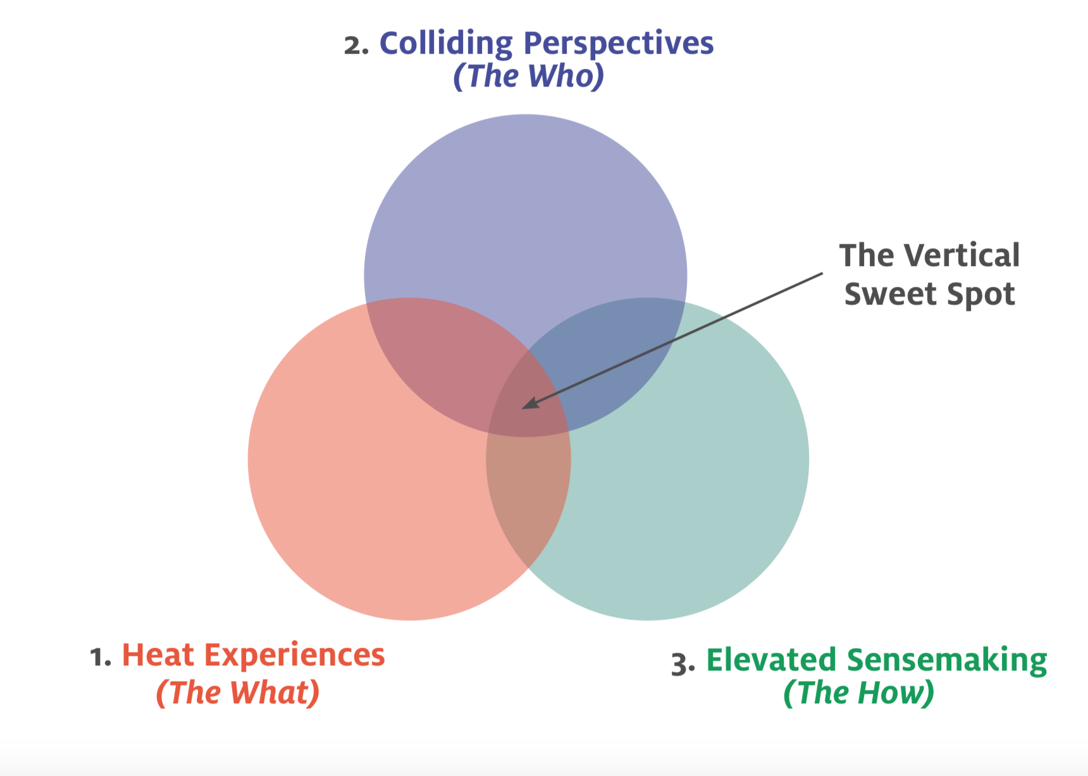
Leader is exposed to people with different worldviews, opinions, backgrounds & training. Increases perspective.
Leader faces complex situation that disrupts & disorients his current methods. Discovers current way is inadequate. Leader’s mind starts to open and search for new & better ways to make sense of the challenge.
Leader uses a process or a coach to integrate and make sense of the perspectives. A larger more advanced world view emerges.
Center for Creative Leadership

Slide 31
Heat experiences
It is a first-time experience
Results matter
There is a chance of success & failure
Important people are watching
It is extremely uncomfortable
4 Development Experiences
Managing 15 people / Now 150
Asked to quickly correct an underperforming business unit where morale is low
You have lived in the West all of your life and now you are asked to open and grow an office in China.
You did a great job on the Admissions Team now you are asked to become a Head of School

Slide 32
Colliding perspectives
Spend a Day in Your Customer’s Rice Paddy
– See the World through Someone Else’s Eyes – John Deere
Deep Listening – content, emotion, value
Leaders Go First
Polarity Thinking ( 2 opposing Ideas/standardization vs. customization)
– See, map, assess, learn, leverage

Slide 33
Elevated sense making
Time for Reflection
Teach Mindfulness & Meditation – Calm App Iphone
Guide – Coach/Mentor
Pair High Potentials with Late-Stage Mentors
Map
Horizontal – Assessments
Vertical – Progress over Time
Change the Body – Get Out of Your Head
Exercise
Dance

Slide 34
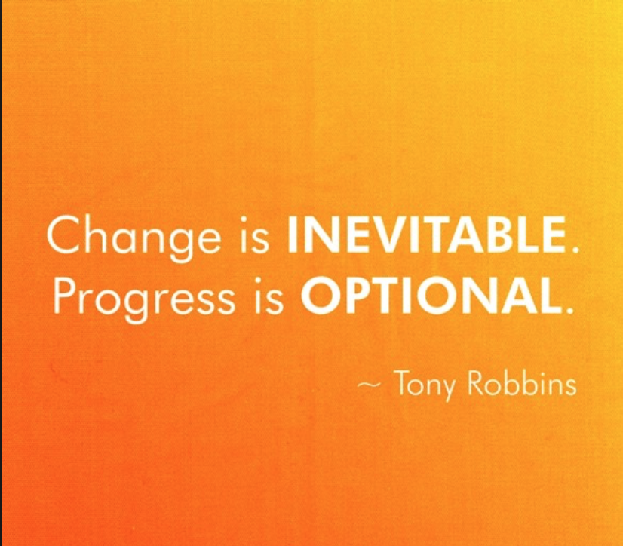

Slide 35
Remember, This is What We are Going For…

Slide 36
Sources and Credits
Forbes, Horizontal vs. Vertical Growth Model
Pixabay, stock images
High Point University, QEP, White Paper
Center for Creative Leadership, Models
Mastering the Cube Excerpt, Reed Deshler, Kreig Smith & Alyson Von Feldt (AlignOrg Solutions)
HBR, books and Articles
Carol Dweck, Mindset
A Pep Talk, Kid President, Video
Tony Robbins, Various books
Daring Greatly, Theodore Roosevelt
Sentis – Neuroplasticity
Top Truths – Top 10 Ways to Train Your Brain

