Slide 1
BRAIN SCIENCE AND YOUR PERFORMANCE
Rebecca Eckstein, MA, CEC, PCC

Slide 2
WELCOME
REBECCA ECKSTEIN, MA, CEC, PCC
INFO@ADMISSIONNETWORK.ORG
WWW.ADMISSIONNETWORK.ORG
ECKSTEIN EXECUTIVE COACHING INSTITUTE
INTRODUCTION
YOUR BRAIN
NEUROPLASTICITY
OPTIMAL PERFORMANCE

Slide 3
INTRODUCTION
30 Years Higher Education
BA, Mary Baldwin, MA, Hollins
CEC, Center for Executive Coaching
ICF, Certification as Professional
Certified Coach
MIT, Neuroscience in Business
IOC, Harvard Medical, Coaching in
Healthcare
Founder Admission Network &
Eckstein Executive Coaching

Slide 4
Your Body is a House YOU Need to live in for 80 Years
We work out, go to the gym, take care of our body – our house. But what about our
Brains. No one sees our brain. With the same self-care, we can turn back the clock on aging, show up productive everyday, and live a longer and happier life.

Slide 5
YOUR BRAIN
Complex organ that controls thought, memory, emotion, touch, motor skills, vision, breathing, temperature, hunger to regulate body functions
Functions depend on the neuron transmissions
Contains blood vessels, cells & neurons (100 billion)
3lbs
Notes:
Your body is a house you need to live in for 80 years. You are thinking right now she is supposed to be talking about our brains, but there is a huge connection between our brains and our bodies. The brain is the CEO of the body.
Our brains have 100 Billion neurons and connect 500 trillion points that travel at 268 miles per hour. 100 Billion is about the number of known stars in the milky way. To give you even more perspective, your cat has only 300 million neurons.
The brain weighing in at only 3 lbs uses 20 % of the oxygen and blood in your body. A piece of brain tissue the size of a grain of sand contains 100,000 neurons and creates 1 billion connections, generating 23 watts of power. Enough power to run a lightbulb.
The brain isn’t fully formed until age 25, so most of the students we are working with, and some of your colleagues are not 100% complete yet in brain formation.
To give you an idea of the growth, the brain triples in size the 1st year of life. Our memories are sharpest at age 18, so even though the brain is not completely formed yet, the memory is at its best.
And just 2 percent of body dehydration can have a negative impact on brain functions.

Slide 6
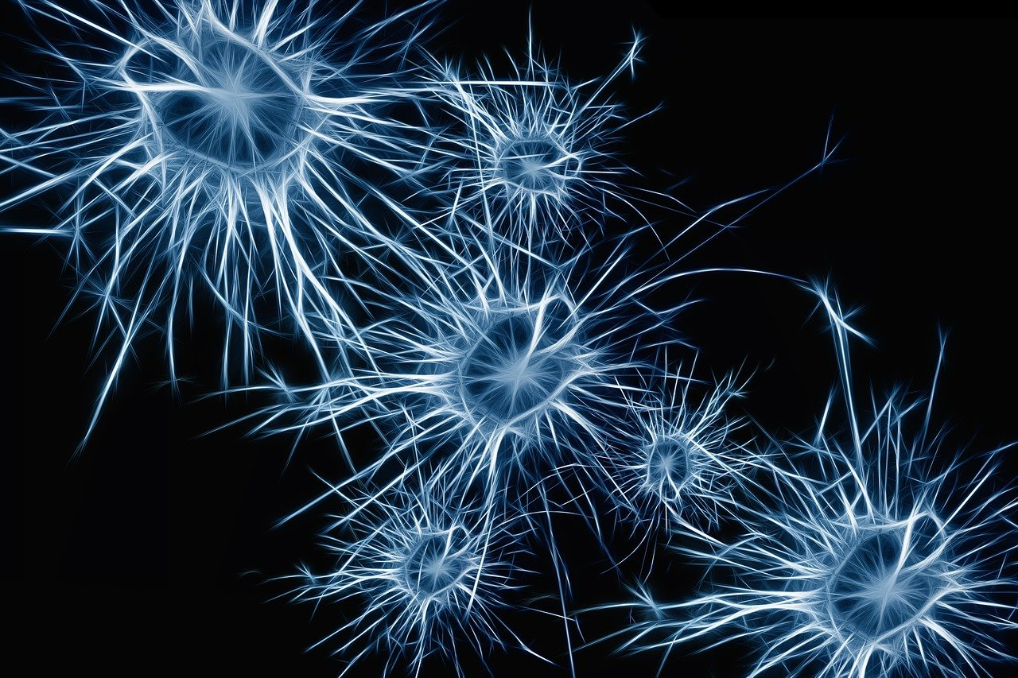
NEUROPLASTICITY
Ability of neural networks in the brain to change through growth & reorganization
Learning increases the number of connections between neurons
Naturally neurons shrink as we age and connections drop which affect learning & memory.
Brain processing speeds come from the efficiency and strength of
neural connections
Notes:
That 268 miles per hour, comes from the strength of your neural connections. And learning increases the number of connections. Your neural connections can also reorganize ( during sleep). And unfortunately they shrink as we age, if we are not careful. So if you want to maintain your 18 year old memory and your fully formed brain at age 25, we need to take care of it.
This is the reason for the session.

Slide 7
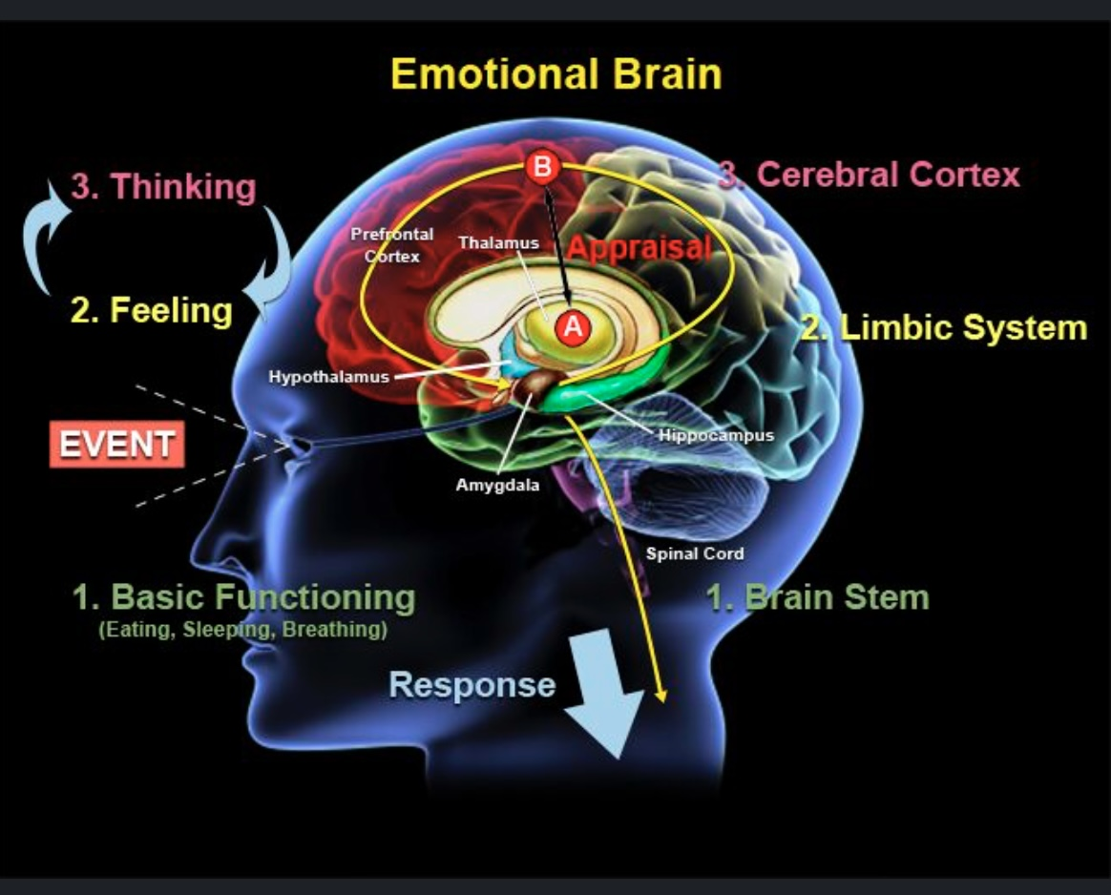
WHY Is this Important?
OPTIMAL PERFORMANCE
Powerful Brain
Powerful Student
Powerful Leader
IMPROVED HEALTH FOR LONGEVITY
2030, 75 Million people Dementia AND
By 2050, 135 Million
Life-Insurance Cognitive Test
Notes:
Taking care of our brains – our CEO helps us maintain our emotional control and eliminates dementia. A Powerful Brain creates a Powerful Student, and a Powerful Leader. So if you want to be at your best, and if you want to counsel your students to be at their best, you need this session. It will increase your longevity and happiness.
Fact check it if you like. Without self-care, 75M people will have dementia by 2030. it begins slowly. You walk into a room and forget why you went in there. You lose your car keys, and your wallet. You forget important birthdates. You get frustrated, and embarrassed, and no one told us this when we were 30, or 40; which is why I am here today – to help as many of you as I can, with 5 relatively easy habits.

Slide 8
This Photo by Unknown Author is licensed under CC BY
Pencils down
Breathe in for 4, hold it for 4, and exhale 4

Slide 9
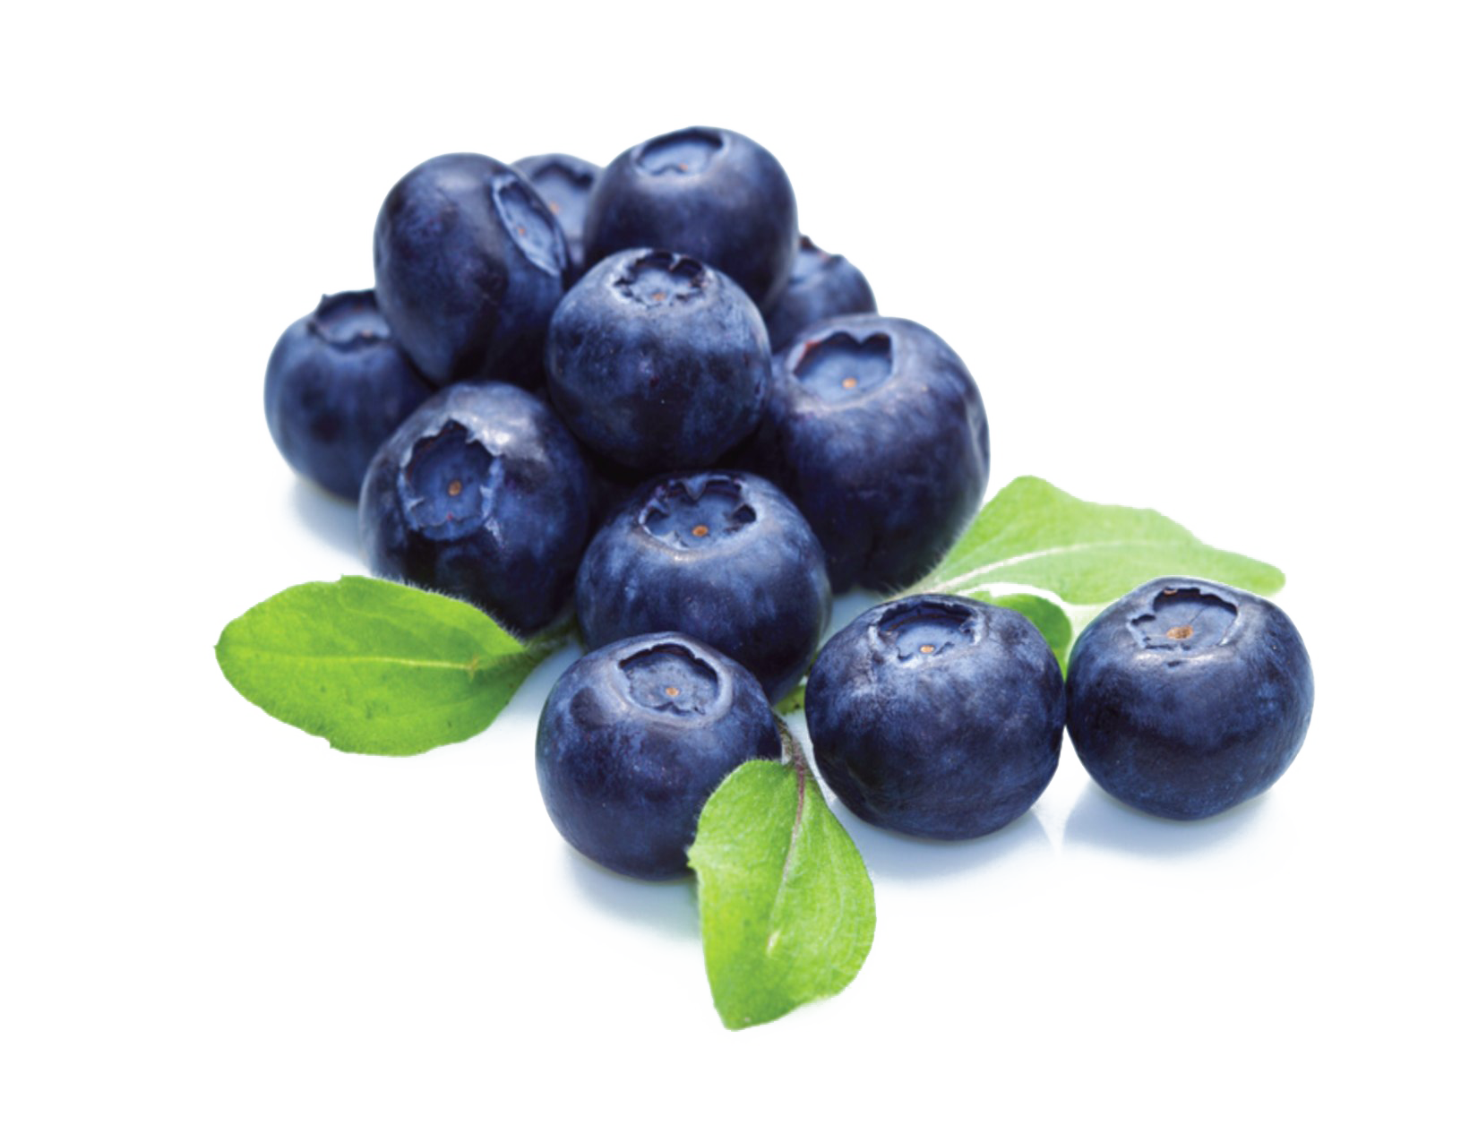
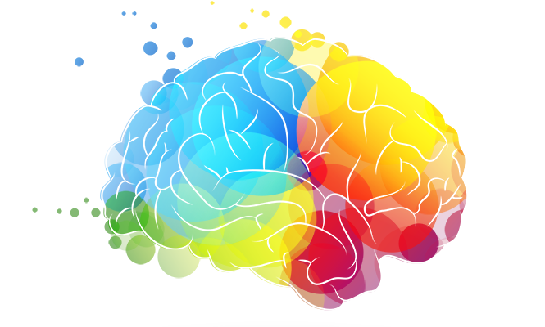
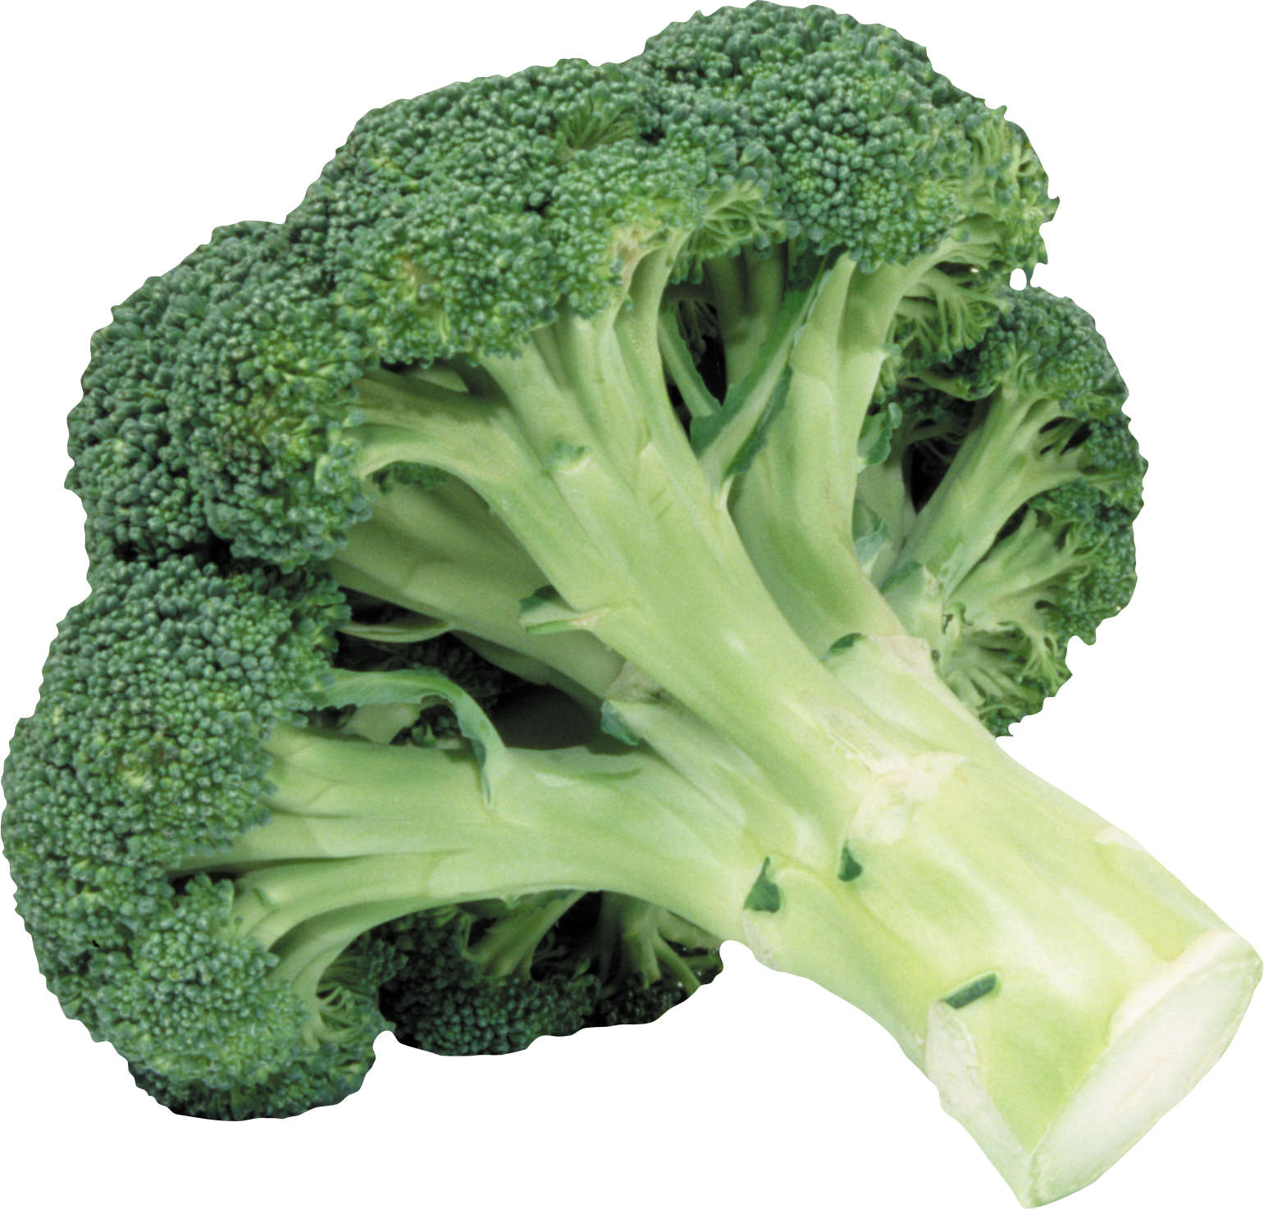
This Photo by Unknown Author is licensed under CC BY-NC
This Photo by Unknown Author is licensed under CC BY-NC
This Photo by Unknown Author is licensed under CC BY-NC
This Photo by Unknown Author is licensed under CC BY-NC

Slide 10
HOW DO WE ACHIEVE OPTIMAL PERFORMANCE?
HYDRATION
NUTRITION
EXERCISE
MEDITATION
SLEEP
Notes:
Here they are – 5 easy habits for optimal performance. Athletes do it, why shouldn’t you?
If I haven’t convinced you yet that this is important, wait until you have to take a cognitive test to get your life insurance policy. If you score lower than their standard, it could cost you money on a $500,000 life insurance policy that could be as much as $2500 a year. Over 10 years that is $25,000! Each higher rating adds an additional 25%. You have taken care of your body all these years, gotten the medical check-ups, didn’t smoke, or abuse drugs or alcohol, and now your brain impacts your life insurance rating.
So let’s do an activity. I want you to look at the objects that fly into the screen. Don’t write them down. Just focus for 1 minute, and try to remember as many as you can.

Slide 11
HYDRATION

Slide 12
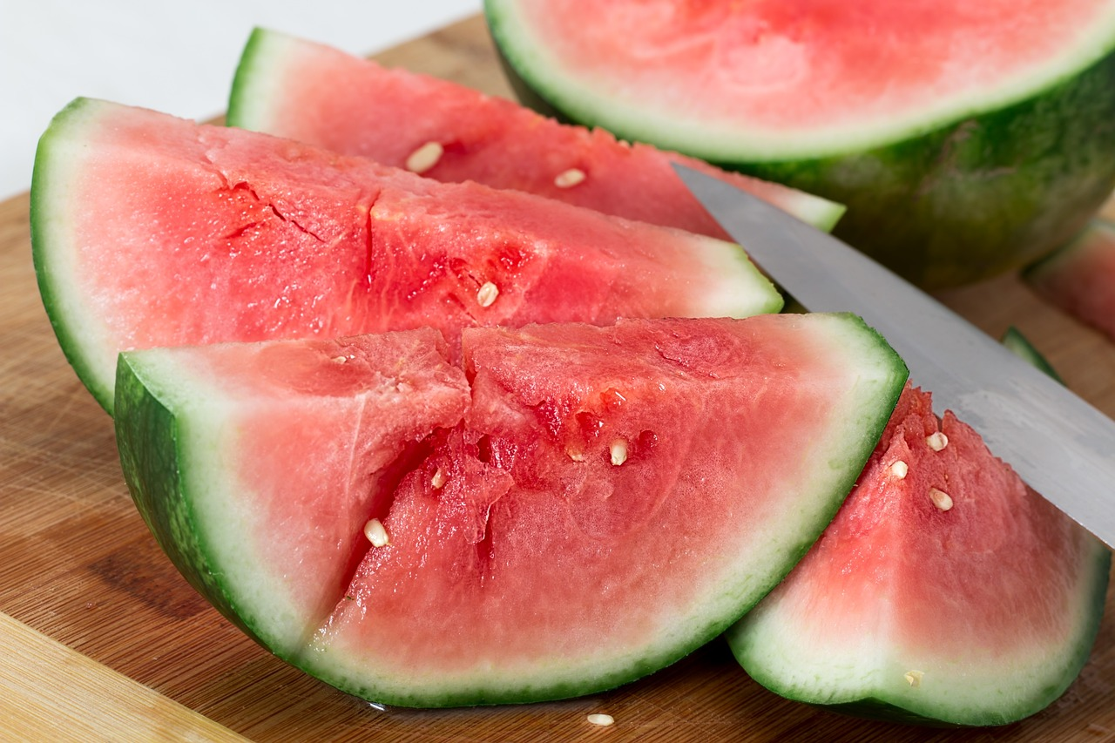
75% Americans chronically dehydrated & just 2% dehydration slows your brain
Proper hydration ensures that neurons can send electrical signals efficiently
When dehydrated, the balance is disrupted, leading to impaired signal transmission
Even mild dehydration can lead to difficulties with memory, attention and concentration reducing
cognitive performance
Notes:
The average person needs 2 Liters per day or about 65 ounces, 4 of these water bottles. You can refill them, and save the oceans while you are saving your brain.
Water hydrates your cells, cerebrospinal fluid, and your blood.
It also regulates your temperature. Overheating impairs cognition.
Dehydration can also impact your mood and emotions. Even mild dehydration causes irritability.
Right before the SATs or ACTs encourage your students to increase their water intake, it will hopefully improve their concentration and their

Slide 13
NUTRITION

Slide 14
Essential nutrients play a crucial role in maintaining & promoting brain health
Omega-3s associated with improved cognitive function, memory, & learning
Antioxidants protect brain cells from oxidative stress & damage. Intake of antioxidants preserve cognitive function
B Vitamins essential for production
of neurotransmitters &
mental well-being
Notes:
So let’s talk Omega-3’s and Omega-6’s – fatty acids are the structural components of brain cell membranes and play a role in transmissions – thinking!
Eat Fatty fish – Salmon, Mackeral, Sardines,
Oxidative Stress & Damage –Oxidative stress damages cells, proteins and DNA. This can result in inflammation, diabetes and cancer. It is an imbalance in the free radicals that are produced during metabolic processes. This damage contributes to aging. Symptoms are chronic fatigue, digestive disorders, memory loss, joint pain, sensitivity to noise. Cure: Add antioxidants: red, purple, green, yellow, orange – eat a colorful diet, and I don’t mean gummy bears.
B vitamins are essential for producing serotonin and dopamine and DNA repair which is important for cell maintenance.
.

Slide 15
Vitamin D enhances brain development
Zinc is essential for memory formation and regulation of neurotransmitters. Deficiency leads to cognitive deficits, impaired learning and emotional disturbances
Magnesium balances mood disorders
Iron provides oxygen
Superfoods provide nutrient dense health benefits
Take Your Food
Collagen
Notes:
Vitamin D, & Magnesium low levels cause mood disorders, depression and cognitive decline
Iron produces oxygen for the brain to receive other nutrients and enhances attention span, reducing fatigue,
Zinc - low levels impair learning and cause emotional disturbances
Superfoods - #1 Antioxidant Blueberries, 1 cup, wild, fresh or frozen
Study – 122 older adults aged 65-80, using a randomized, double blinded, placebo-controlled 6-month study found on a batter of cognitive tasks targeting episodic memory, working memory and executive function, alongside mood and cardiovascular health found significantly better performance after 3 months on memory tasks, BP and cardiovascular risk factors. Flavonoids including anthocyanins reduce oxidative damage.
All the fruits, Leafy Greens, Nuts, Tumeric (Curcumin), Quinoa, Green Tea, Dark Chocolate, Avocado, Seaweed, Greek Yogurt

Slide 16
EXERCISE

Slide 17
Only 23% of adults in the U.S. meet the physical activity guidelines by CDC
Exercise stimulates the production of new neurons in the hippocampus, critical to learning & memory
This process; neurogenesis contributes to cognitive flexibility & adaptability.
Exercise boosts the release of BDNF, a
growth factor that supports improved
learning, memory & cognition
Reduces stress
Notes:
6,000 steps a day – at least.
Exercise promotes blood circulation.
Exercise boosts the release of BDNF (Brain Derived Neurotrophic Factor), a growth factor that supports the survival and growth of neurons
Regular exercise increases the brain’s capacity for neuroplasticity, allowing it to adapt and reorganize. This is essential for memory
Exercise reduces stress and cortisol. Lower stress – Better Brain cognition
Regular exercise improves executive functioning, decision-making, problem-solving, improves attention span and concentration.

Slide 18
MEDITATION

Slide 19
86% of Adults do not practice
Stress reduction – cortisol reduction
Enhanced emotional regulation
Improved Sleep – enhances quality
Cultivates attention control, improved focus and concentration
Reduces mind wandering
Improved decision making
Enhanced brain structural changes
Notes:
Meditation regulates cortisol production. Elevated cortisol is associated with chronic stress, anxiety and health issues resulting in lower cognitive performance.
Meditation increases sleep quality.
Neuroimaging has shown that meditation leads to structural changes in the brain, including the increase of gray matter density regions associated with memory, learning and self-awareness.

Slide 20
SLEEP

Slide 21
35% of adults in U.S. get less than 7-9 hrs. of sleep as recommended by CDC
Sleeps enhances memory consolidation
Car wash for your brain – waste cleared
Strengthens newly acquired information leading to improved learning, memory retention and cognitive performance
Sleep aids in problem-solving
Emotional Regulation
Elixir of Life
Notes:
Sleep Allows for memory consolidation, enhancement, synaptic pruning. It is like a car wash for your brain. Everything is spritzed off, vacuumed off and shiny and new to start the next day.
Sleep also supports emotional regulation, reducing the negative intensity of negative experiences
Sleep supports attention and alertness
Sleep contributes to neuroplasticity, allowing the brain to adapt and learn from experiences, and rewire itself in response to new information and challenges.
To explain how important just 1 lost hr. of sleep can be, research studies from the New England Journal of Medicine on the day after Day light savings time in the spring. There is a 24% increase in heart attacks, and 30 more deaths annually occur on that day, and in the fall when they give you an hour, heart attacks go down by 21%. Interrupted sleep impacts the bodies natural rhythm

Slide 22
How Will You
Implement These Crucial Changes to Your Maximize your Health?
Mentor your students to make wise choices?
Spread the word about the importance of performance and cognitive function derived from Hydration, Nutrition, Exercise, Mediation and Sleep?
Goals?
Notes:
Back to our activity, write down what your remember, Give you 2 minutes.
Who has 10 or more?

Slide 23
Sources:
Center for Disease Control, (CDC)
Images, Pixabay.com
International Coaching Federation (ICF)
Massachusetts Institute of Technology (MIT)
Medical Daily
New England Journal of Medicine
Sleep is Your Superpower – Matt Walker (TED)
Sleep Scientist – Dan Gartenberg
World Health Organization, (WHO)

Slide 24
Please fill out the evaluation for this session.
Your feedback helps IECA plan for future conferences and evaluations are required for receiving CE credit. You will find the evaluation link in the listing for this session in the conference app.

